Slide 1
Cybersecurity Innovation: Some Recent Examples from Government
July 27, 2017
Douglas Maughan
Cyber Security Division Director

Slide 2
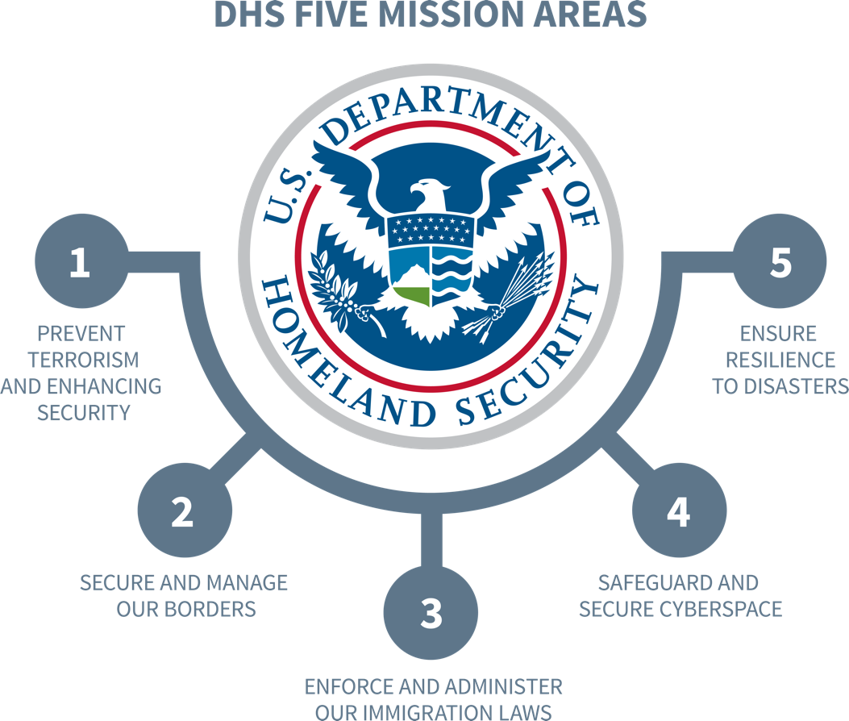
S&T Mission
To deliver effective and innovative insight, methods and solutions
for the critical needs of the Homeland Security Enterprise.
Notes:
S&T strives to develop and implement technology solutions that address our nation’s most pressing homeland security challenges.
S&T efforts are aligned with five mission areas of the Department of Homeland Security shown on the slide.
S&T views the Department’s mission areas through a technology lens, seeking capabilities for preventing terrorism, securing our borders, enforcing immigration laws, securing cyberspace, and strengthening resilience to disasters.
We work collaboratively with many partners in the private and public sectors to identify, develop and share resources, capabilities, ideas and perspectives about best practices and methodologies for protecting the nation.
S&T seeks new and innovative ways to bring our many partners together to stimulate fresh thinking and innovative solutions to ensure the safety and resiliency of our communities, and of those who protect them.

Slide 3
DHS and Cybersecurity
MISSION 4: SAFEGUARD AND SECURE CYBERSPACE
  Goal 1: Strengthen the Security and Resilience of Critical Infrastructure
  Goal 2: Secure the Federal Civilian Government Information Technology Enterprise
  Goal 3: Advance Law Enforcement, Incident Response, and Reporting Capabilities
  Goal 4: Strengthen the Ecosystem
  Drive innovative/cost effective security products, services, and solutions in the cyber ecosystem;
  Conduct and transition research and development enabling trustworthy cyber infrastructure;
  Develop skilled cybersecurity professionals;
  Enhance public awareness and promote cybersecurity best practices; and
  Advance international engagement to promote capacity building, international standards, and cooperation.
Notes:
In August 2015, DHS Secretary Jeh Johnson re-established integrated product teams to coordinate R&D efforts across DHS. The new IPTs cover these mission areas: Aviation Security, Biological Threat, Counterterrorism, Border Security and Cyber Security. An IPT-like initiative dedicated to responders pre-dated the new IPTs and was incorporated into the new framework.
The IPTs brought together some of the best operational and technical minds at DHS and the governance structure embraced a culture of collaboration.
Drawing on expertise resident in the IPTs, sub-IPTs, and the Science and Technology Research Council, the IPT process compiled information on R&D activities across DHS in an unprecedented way. The information gleaned from the IPTs provides an invaluable tool for DHS as we collaborate to manage our vast mission space and make wise technological investments.
While S&T is leading the overall effort, the individual IPTs were led by senior executives from DHS components, with participation from representatives of the Joint Research Council. In this way, the IPT process supports and strengthens
the Department’s Unity of Effort initiative.

Slide 4




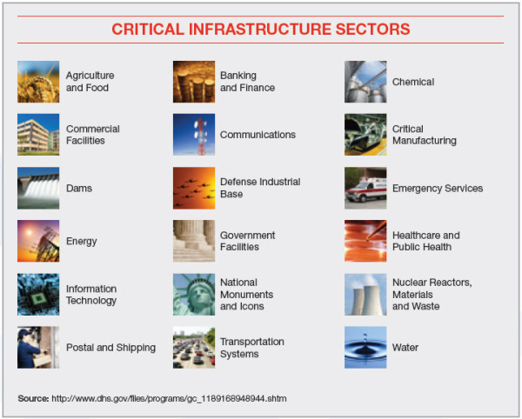











Research Requirement Inputs
DEPARTMENT INPUTS
INTERAGENCY COLLABORATIOIN
WHITE HOUSE & NSS
CRITICAL INFRASTRUCTURE SECTORS
(PRIVATE SECTOR)
STATE & LOCAL
CYBERSECURITY R&D
INTERNATIONAL PARTNERS
Notes:
S&T must balance its broad mission areas against its limited resources. So we have learned to build partnerships and collaborations with key groups to leverage and augment our capabilities and achieve mission success in discovering and implementing technology solutions for protecting the nation.
We take a unified approach to problem solving within the DHS mission areas to support operators securing our borders and to protect our communities and critical infrastructure.
We are focused on achieving specific milestones through our Apex programs, each of which is dedicated to a specific and pressing homeland security challenge.
We cast a wide net to connect with the best minds, domestically and globally, to find solutions to address the current threat environment. We make special efforts to reach out to nontraditional government performers – start up companies, the maker community, citizen scientists, college professors, university researchers – for innovative approaches to problem solving.

Slide 5



CSD Mission & Strategy
Aviation Cybersecurity
Cyber for Critical Infrastructure
Cyber Physical Systems Security
Cyber Risk Economics
Cyber Security for Law Enforcement
Cybersecurity Outreach
Cyber.Gov
Data Privacy Technologies
Identity Management
Homeland Security Open Source Technologies
Human Aspects of Cyber Security
Mobile Security
Next Gen. Cyber Infrastructure Apex
Network System Security
Research Infrastructure
Silicon Valley Innovation Program
Software Assurance
Transition to Practice
Develop and deliver new technologies, tools and techniques to defend and secure current and future systems and networks
Conduct and support technology transition efforts
Provide R&D leadership and coordination within the government, academia, private sector and international cybersecurity community
Cyber for Critical Infrastructure
Cyber Security for Law Enforcement
Cybersecurity Outreach
Cyber Physical Systems
Data Privacy Technologies
Identity Management
Homeland Security Open Source Technologies

Slide 6
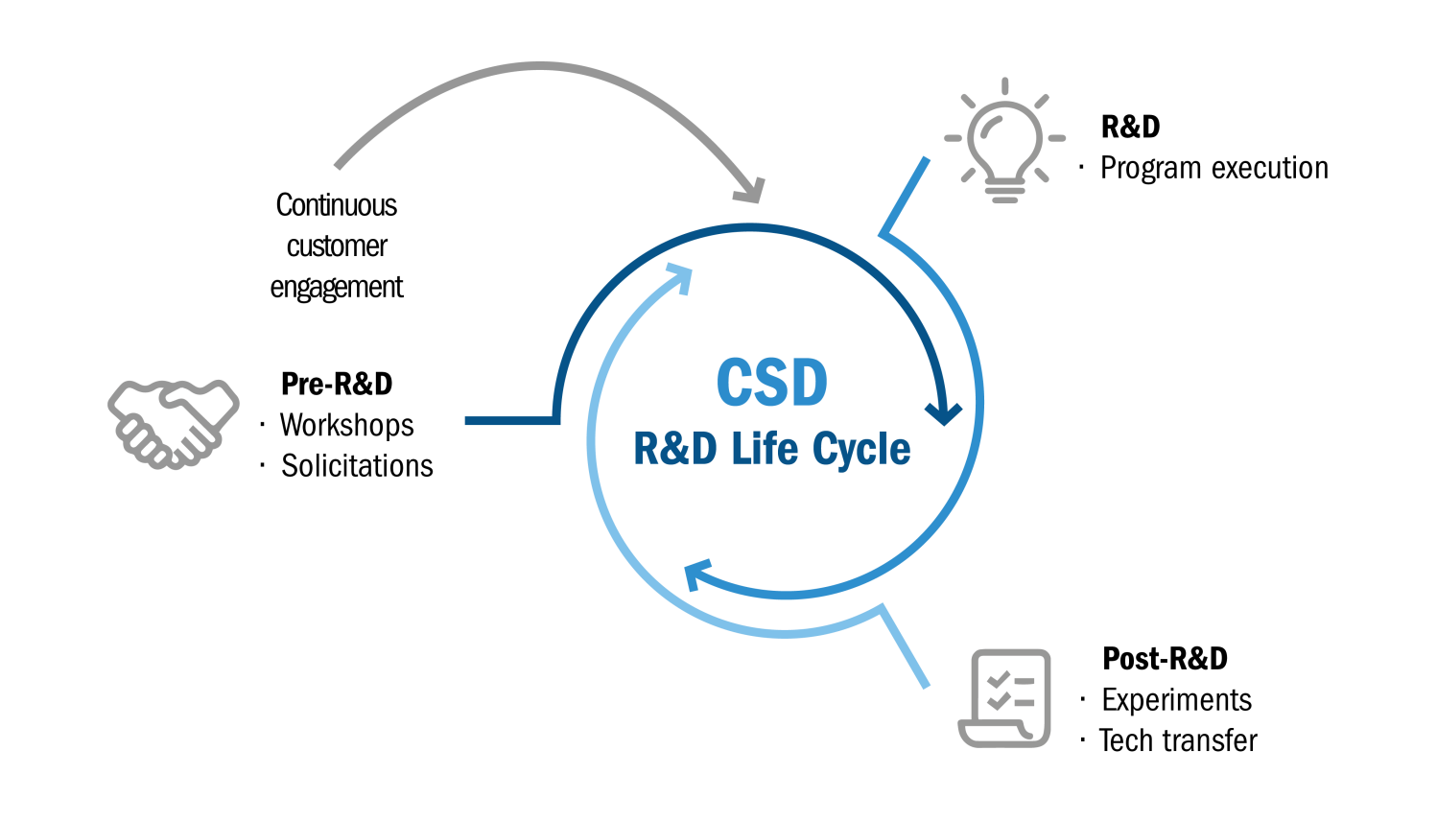
CSD R&D Execution Model
Successes
Over 75 technology products transitioned since 2004, including:
2004 – 2010
  11 commercial products
  3 Open Source products
  1 GOTS product
2011 – 2014
  12 commercial products
  3 Open Source products
  2 Knowledge products
2015 – 2017
  16 commercial products
  2 Open Source products
  3 Knowledge products
Small Business Innovative Research (SBIRs)
  10+ commercial products
  2 Open Source products
"Crossing the ‘Valley of Death’: Transitioning Cybersecurity Research into Practice,"
IEEE Security & Privacy, March-April 2013, Maughan, Douglas; Balenson, David; Lindqvist, Ulf; Tudor, Zachary
http://www.computer.org/portal/web/computingnow/securityandprivacy
6

Slide 7
Recent Transitions and Pilots
Technology | Performer | Pilot or Transition Partner | Status
Blackthorn GPS Forensics | Berla | ICE, USSS, CBP | Commercialized
iVe Vehicle and Infotainment Forensics | Berla | ICE, CBP, DoD, State/Local, DoJ | Commercialized
NIST Forensics Tool Test Reports | NIST | Publically Available | Knowledge Products
Mobile Device Management | Mobile Iron | FEMA | Pilot and adoption by 10K users
Mobile App Security/Mobile App vetting | Kryptowire | CBP, DHS HQ, US CERT | Pilot
Malware analysis tool | Hyperion | US CERT | Pilot
Hardware Enabled Zero Day Protection | Def-Logix | DoD/USAF | Pilot
Symbiote embedded device protection | Red Balloon Security | Hewlett Packard | Commercialized
Policy Guru for TDOS Defense | SecureLogix | NG911, Banks, Hospitals | Three pilots
TTP Project | Technology | Transition Path | Outcome
PathScan (FY13 Cohort) | Network Anomaly Detection | Commercialization | Licensed by EY, integrated in services
NeMS (FY13 Cohort) | Network Characterization and Discovery | Commercialization | New company raising capital
CodeDNA (FY14 Cohort) | Malware identifier for community-based defense | Government Use | In use by DoD, US Cert
ZeroPoint (FY15 Cohort) | Weaponized Document detection | Commercialization | New security startup formed
PEACE (FY17 Cohort) | Policy Enforcement and Access Control for Endpoints | Commercialization | New security startup formed
PcapDB (FY16 Cohort) | Optimized Full Packet Capture | Open Source | Available for operational use
Keylime (FY17 Cohort) | TPM Based Trust in the Cloud | Open Source | Available for operational use

Slide 8
The LOGIIC Model of Government and Industry Partnership
  LOGIIC is an ongoing collaboration of oil and natural gas companies and the U.S. Department of Homeland Security, Science and Technology Directorate (DHS S&T).
  LOGIIC facilitates cooperative research, development, testing, and evaluation procedures to improve cyber security in petroleum industry digital control systems.
  LOGIIC undertakes collaborative research and development projects to improve the level of cyber security.
  LOGIIC promotes the interests of the sector while maintaining impartiality, the independence of the participants, and vendor neutrality.
Linking the
Oil and
Gas
Industry to
Improve
Cyber Security
In 2012, LOGIIC received the DHS S&T Under Secretary’s Award for Outstanding Collaboration in Science and Technology. LOGIIC has been commended by DHS S&T as a unique framework and a model for establishing similar consortia across other critical sectors.

Slide 9

Collaborative R&D
LOGIIC Broke New Ground in Consortium Governance
DHS S&T
The Automation Federation (AF) serves as the LOGIIC host organization.
The U.S. Department of Homeland Security, Science and Technology Directorate has contracted with the scientific research organization SRI International to provide scientific and technical guidance for LOGIIC.
Member companies contribute and provide staff to serve on the LOGIIC Executive, Technical and Outreach Committees. Current members of LOGIIC include BP, Chevron, Shell, Total and other large oil and gas companies that operate significant global energy infrastructure.
AF
SRI
Member Companies
Member Companies
Executive
Technical
Outreach
Notes:
Notes from Bullet 1:
Members approved a participation agreement with AF
Each project is covered by a Project Addendum to this agreement
Notes for Bullet 2:
Member companies contribute financially and technically, provide personnel who meet regularly to define projects of common interest, and provide staff to serve on the LOGIIC Executive and Technical Committees.
LOGIIC Members designate representatives from member companies to participate on the various committees
LOGIIC Members meet quarterly for Face-to-Face meetings and bi-monthly for Executive and Technical committee phone meetings
LOGIIC participates in US and International outreach events to share project results with the Industrial Automation Control System and Cybersecurity Community
Executive: Responsible for strategic decisions for LOGIIC. Each member company has one vote.
Technical: Defines the technical direction and scope of the projects and provide guidance to the executive committee
Outreach: Provide the interface to the industry and community on LOGIIC deliverables and messages

Slide 10
LOGIIC Projects Framework
Select Project
Project concepts developed
Study (as needed)
Technical study or Survey
Project Specification
Project concept becomes specification (recycle if needed) including plan, budget, etc.
Prior Year
Select Vendors/SMEs
Develop detailed test plans, etc.
Execute
Perform lab test
Select parties to participate in and perform work for project
Design
Current Year
Reporting
Produce Technical Report THEN Public Report
Outreach
Share knowledge with industries
Next Year

Slide 11
LOGIIC Projects Timeline (2005 – 2015)
LOGIIC Consortium Formation
2007-2008
Wireless Project 2011-2012
HPS Project 2010-2011
Correlation Project 2005-2006
SIS Project 2009-2011
Standards Project 2010-2011
FAT/SAT Project 2012-2013
Virtualization
2013-2014
Mobility
2015-2016
Future Projects
Road Map
Remote Access
2013-2014
Real Time Data Transfer
2014-2015
SIS Project
2016-2017
Public reports and presentations are available on the LOGIIC website
Notes:
Industrial control, automation, package, security, and other vendors, as well as subject matter experts, have made LOGIIC projects possible by volunteering their time, knowledge, equipment and test environments.

Slide 12







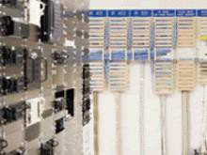


Critical Infrastructure Resilience Institute
Chemical
Commercial Facilities
Critical Manufacturing
Dams
Emergency Services
Government Facilities
Information Technology
Nuclear Reactors, Materials and Waste
Transportation Systems

Slide 13
Application Themes for CIRI
Insurance and Business Case for Resilience
Find economic ways to spread risk, primarily in flood and cyber realms
Technologies able to assess risk to standards acceptable by insurers
Information sharing frameworks
Macro and Micro Industrial Supply Chains
“micro” means intra-organization, “macro” means inter-organization
Resilience issues in embedded systems
Analysis of resiliency in business and policy context
Infrastructure Dependencies and Interdependencies
“Situational awareness” of system dependencies/interdependencies
Exploration of resilience governance issues
Models of economic/social/physical impact of upsets
Communication
Dependency of critical infrastructures on communication
Mobile, Internet

Slide 14
Finance Sector Transition Project
Leverage existing federally funded and private sector research Integration, testing and evaluation Predominantly development
Establish the Cyber Apex Review Team (CART): DHS S&T + FS Critical Infrastructure + Treasury partnership Monthly meetings Collaborate on: Sector needs and gaps identified (relevance) and ranked (direction) Common ontology to join needs to technology areas Task proposal evaluation
Execute via Other Transaction Authority (OTA) Adaptable consortium of performers Quick turn-around for task orders (acceleration) Flexible engagement with CART Iterate through the tech areas defined by CART
Apex Participant Levels:
L₁: Government Only
L₂: CART Members
L₃: CART + OTA Performer
DHS S&T
Treasury
CIPP
Financial Sector
OTA Performer
Notes:
Gaps and risks: Risk is an attribute of a gap. For instance, there may be a gap in data recovery, but the associated risk is deemed low. Alternatively, there is a gap in network event detection, and the CART has indicated that the risk is high. A gap is a gap, but risk says how bad it is.
This is essentially the program plan. We plan to leverage a tech pool, establish a CART, and use an OTA to execute.

Slide 15
Functional Gaps and Technology
Impacts
Hybrid Analysis
Network Characterization
Malware Detection
Data Leakage
Dynamic Defense
Insider Threat
Visual Analytics
Zero Day Protection
Network Mapping
Situational Understanding
Malware Classification
Malware Execution Prevention
Reduce Financial Sector risk due to cyber attack
Intrusion Tolerance
Dynamic Network Architecture
Software Assurance
Defend and deter cyber adversaries and limit the effect of cyber threats to information and operations
Functional Gaps
Identified by the Finance Sector *Subject to revision based on evolving requirements*
Technology Areas
Leverage previous investments and existing technologies
Over $60M in S&T funds invested in cyber security since 2010
Over $20M in Government Lab funds invested in cyber security since 2010
Private funding amounts as identified by the finance sector
Notes:
Now, the idea is to connect needs to existing research.
The unique character of this program, though, is that it’s focused on development and transition; the D in R&D.
In meetings with Finance Sector leadership, starting about a year ago, we identified a number of functional gaps, representing cyber security needs.
Sector leadership has prioritized these gaps as having the most influence on reducing cybersecurity risk.
To each gap, we’ve associated one or more technology areas in which either DHS S&T or Government Labs have invested.
To date, that investment exceeds $80M and is growing.
Please note that rather than taking the position that “we’re from the government and we’re here to help”, we have formed a partnership with the Department of Treasury and the Financial Services Sector and *listened*.

Slide 16

Customer Buy-in
Active participation (June 2015 – present):
Strategic Direction
  Ranked capability needs mapped to technology areas, providing roadmap for task selection
Technical Guidance
  Technology and architecture surveys specific to FSS
Initial tasks
  NetAware: net situational awareness
  NetIdentify: net structural awareness
Working with:
Bob Blakley, Global Director for Information Security Innovation, Citigroup
Byron Collie, Vice President, Threat Management, Goldman Sachs
Ellen Moskowitz, Vice President, Corporate Information Security, State Street
Parthiv Shah, SVP, CISO, The Clearing House
George Smirnov, SVP, CISO, Comerica
Sounil Yu, SVP, Director of R&D, Global Information Security, Bank of America

Slide 17














International Engagement
Cybersecurity is not a U.S.-only problem, everyone has the same problems; why not work on them together?
Opportunities to leverage international funding for R&D and investment

Slide 18
International Engagement
Published 5-year International Broad Agency Announcement
  https://www.fbo.gov/spg/DHS/OCPO/DHS-OCPO/HSHQDC-17-R-B0001/listing.html
Published first R&D call with The Netherlands on May 17, 2017
  https://www.fbo.gov/index?s=opportunity&mode=form&id=cb58c706d63bb388308528b02cfba7bf&tab=core&_cview=0
Proposals are due August 31, 2017
Topics of Interest
  ICS/SCADA: (1) Digital Data Collection and Analysis; (2) Vulnerability Assessment Tools; (3) Common Operating Picture (COP) Tool; (4) Securing Legacy Systems
  DDOS and DNS: (1) DNS as a DDOS Attack Target; (2) DNS as a DDOS Amplifier; (3) DDOS and IOT Interactions
18

Slide 19
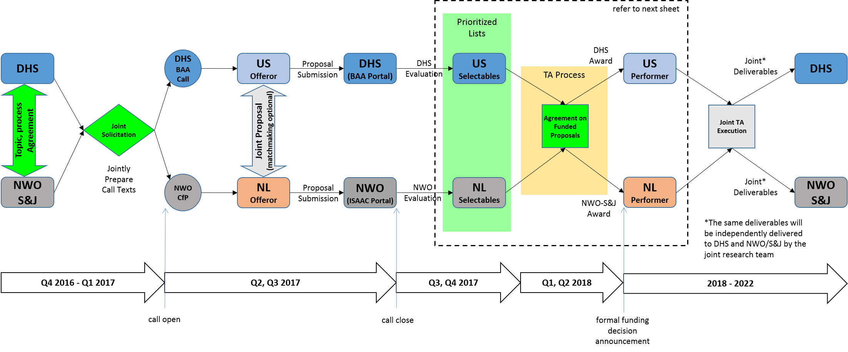
Cooperative Activity Process

Slide 20
Accelerating innovation for DHS and the homeland security enterprise to
safeguard the American people, the homeland and our values.
Silicon Valley Innovation Program
Douglas Maughan, Senior Executive
7-24-17

Slide 21
What We Do
To keep pace with the innovation community and tackle the
hardest problems faced by DHS’s operational missions, we
EDUCATE
Help investors and entrepreneurs understand DHS’s hard problems
FUND
Provide accelerated non-dilutive funding (up to $800K US) for product development to address DHS’s needs
TEST
Provide test environments and pilot opportunities
STREAMLINE
Avg Time to Award:
45 days
LEVERAGE
100:1
$400+M Private Sector

Slide 22


Topics We’re Funding
https://scitech.dhs.gov/hsip
Accepting
Applications:
$
First Responders
Energy Harvesting Fabrics
3D Dynamic Mapping
Identity
Fintech Cybersecurity
Applications
Closed:
Internet of Things Security
Drones
Big Data
K9 Wearables

Slide 23
How We Fund
Potential for $800K; Up to 24 months
Performance-based funding steps
Phase 1 | $50-200K | 3-6 months | Proof of concept demo
Phase 2 | $50-200K | 3-6 months | Demo pilot-ready prototype
Phase 3 | $50-200K | 3-6 months | Pilot test prototype in operations
Phase 4 | $50-200K | 3-6 months | Test in various operational scenarios
Rolling applications reviewed monthly or quarterly, topic-dependent
If invited to pitch, funding decision made same day
Contract awarded within 30-60 days

Slide 24
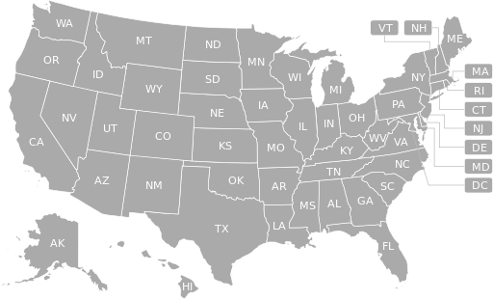
Latest Stats
9
2
Funded Topics
1
3
International
139
3
2
3
2
2
1
1
6
Applications
8
7
34
49
2
1
3
2
4
21
1
3
13
2
Pitches
2
2
20
2
3
8
Startups Funded
Leveraging $400 million private sector investment for $3.8 million spent
45
Days to Contract

Slide 25
Why Us?
Equity-Free
This is a performance based contract. Up to $800K available for every company.
Network
Instant access to DHS public private partnerships and the greater homeland security enterprise, a $544B marketplace.
Mentorship
Learn from the best. We have a deep bench of government and private sector partners who can offer guidance and introductions.
Market Validation
Find market fit through prototype testing and pilot opportunities.
Amplify Your Reach
Demo your product to government, industry and investors from across the world.
Follow-On Funding
Our alumni have received follow-on funding by venture capital investors.

Slide 26


















Portfolio Companies

Slide 27
Summary / Conclusions
Cybersecurity research is a key area of innovation to support our global economic and national security futures
CSD continues with an aggressive cyber security research agenda to solve the cyber security problems of our current and future infrastructure and systems
  Ever-increasing speed of technology change
  Scope/complexity of the different areas of the problem
  The balance of near-term versus longer-term R&D
Will continue strong emphasis on technology transition
Will impact cyber education, training, and awareness of our current and future cybersecurity workforce
Will continue to work internationally to find and deploy the best ideas and solutions to real-world problems

Slide 28

Douglas Maughan, Ph.D.
Division Director
Cyber Security Division
Homeland Security Advanced Research Projects Agency (HSARPA)
douglas.maughan@dhs.gov
202-254-6145 / 202-360-3170 / 202-836-3278
For more information, visit
http://www.dhs.gov/cyber-research

