Slide 1
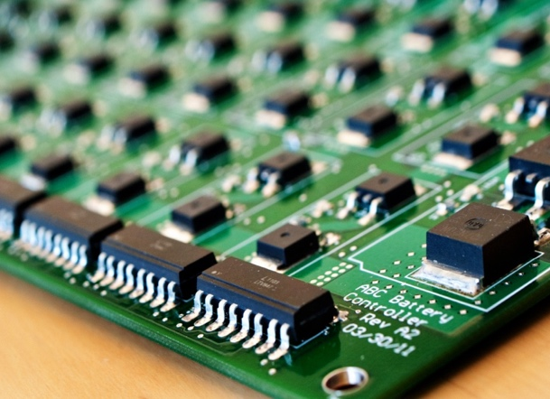
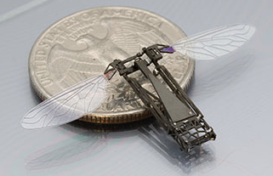
IUCRC Welcome
Advanced
Cyberinfrastructure
Computing & Communication Foundations
Computer & Network
Systems
Information & Intelligent Systems
Jim Kurose
Assistant Director, NSF
Computer & Information Science & Engineering
2017 NSF IUCRC Biennial Meeting
July 27, 2017

Slide 3
NSF/CISE Industry Partnerships, 2014-2017
Individual-project based
I/UCRC: center co-funding (25 CISE centers)
GOALI: faculty/student/industry-researcher exchange
InTrans: technology-transition co-funding
Research-Infrastructure-based collaborations:
cloud credits for BIGDATA, BD Hubs & Spokes programs: AWS, Google, Microsoft
Platforms for Advanced Wireless Research (PAWR)
Workforce, Broadening Participation
Typically via separate co-funding
CSforAll, BPC Alliances (e.g., NCWIT)
Joint research solicitations
joint NSF/industry research solicitations in targeted areas
Intel (4), SRC (5), VMware (1)

