Slide 1
2017 NSF I/UCRC Biennial Meeting
Collaboration of IUCRCs to Solve Grand Challenges
Verena Kallhoff, Managing Director – CyBHOR
Houston Methodist Hospital Research Institute

Slide 2
NSF I/UCRC for Cyber-Physical Systems for the Hospital Operating Room
Director: Marc Garbey, PhD
Director Center for Computational Surgery, HMRI & Director of Research Integration, MITIE
Co-Director: Scott Berceli, MD, PhD –
Professor of Surgery, UF & Chief of Vascular Surgery, NF/SG VHS
Co-PI: Barbara Bass, MD
Chair of the Department of Surgery, Director of MITIE Houston Methodist Hospital
Co-PI: Roger Tran-Son-Tay, PhD
Professor of Engineering, UF

Slide 3
Center Partners
INDUSTRY PARTNERS
Boston Scientific
Karl Storz
GID Medtronic Houston Methodist Hospital Tietronix
Liaison FDA
NSF/CENTER EVALUATOR
Drew Rivers

Slide 4
Clinical and Translational Mission
Mission: Develop technologies that leverage the principles and technology of computational science to the application of surgery and surgical problems both inside and outside of the operating room
Clinical Partners:
UF Health Shands Hospital
Houston Methodist Hospital

Slide 5
Approach to Research and Innovation
Multiscale Modeling
Consider all factors: Human, engineering, environment
Agile Development
End user crucial in development
Interdisciplinary Research
Training & simulation in civil aviation
Computation
Clinical
Sciences
Experimental
Validation

Slide 6
2017 NSF IUCRC Biennial Meeting Collaboration of IUCRCs to Solve Grand Challenges July 26-27, 2017 Bita Kash, PhD, MBA, FACHE CHOT Center Director Texas A&M University
Center for Health Organization Transformation (CHOT)

Slide 7
CURRENT CHOT UNIVERSITY SITES
Awaiting Award in 2017

Slide 8
CURRENT CHOT INDUSTRY MEMBERS (23 members)
Health Systems/Providers (14 members)
Alacare Home Health and Hospice
Care Coordination Institute
Children's Healthcare of Atlanta
Grady
HealthSouth
Lakeshore Foundation
Last Best Chance, LLC
Main Line Health
Morehouse School of Medicine
Opelousas General Health System
Palm Health Foundation
Penn State Health, Milton S. Hershey Medical Center
Texas Children's Hospital
UAB Health System
Retail/Tech/Vendors (5 members)
Carena, Inc.
Quantum Innovation
Restore Medical Solution
Siemens
AT&T
Associations/Government (3 members)
American Society of Anesthesiologists
Central Texas Veterans Health Care System
Pennsylvania Office of Rural Health
Insurers/Payers (1 member)
Highmark
Notes:
ANIMATED SLIDE

Slide 9
NSF I/UCRC MODEL & CHOT’S VALUE PROPOSITION
Industry Advisory Board
Pooled Members
$
University Center Sites
Core &
Supplemental Funds
Investment of Indirects
NSF Funds
RESEARCH PROJECTS
Value
Created
$
Innovations in Healthcare Delivery

Slide 10
ANNUAL RESEARCH CYCLE
Fall CHOT IAB meeting | Winter | Spring CHOT IAB meeting | Summer
Communicate | Coordinate | Collaborate | Create
Research project Presentation IAB members share research ideas and develop research themes | Research proposals developed with IAB input. CHOT sites facilitate collaborative research | Present research proposals IAB provides feedback & ranks research proposals | CHOT sites conduct research projects

Slide 11
CHOT 2017-2018 Research Themes
Handout 3: CHOT 2017-2018 Research Projects
Care Coordination
Access to Care
Analytics and Innovative Technologies
Population Health

Slide 12
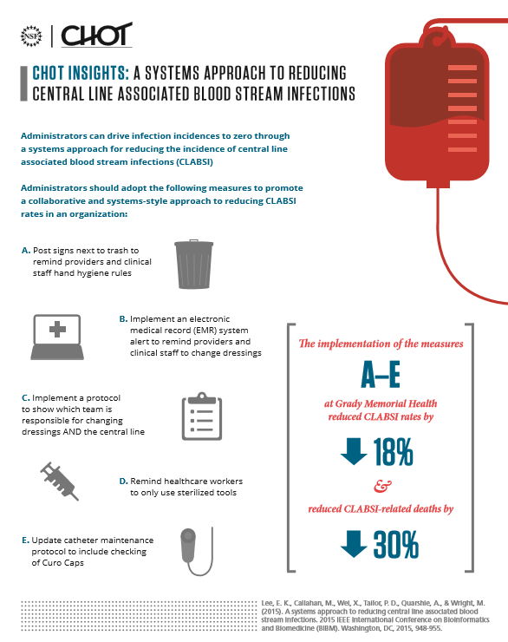
CHOT Insights

Slide 13
GRAND CHALLENGE – AWARDED PLANNING MEETING GRANT
Title: Access to Appropriate Cancer Care for All Americans
Aim: The grand challenge is to ultimately close the rural-urban divide in treatment options, health outcomes, and mortality starting with cancer care first.
Description: The primary focus of this cooperative, industry-led initiative is to explore innovative, technology-driven solutions that can provide patients in rural and isolated communities better access to appropriate care consistent with current medical knowledge and evidence-based practice.
This could be achieved via a distributed organization and network of resources model that 1) empowers and supports rural community physicians and 2) empowers and supports rural community members and patients in achieving participation in a better, and eventually optimal, healthcare delivery system.
Date: November 07, 2017
Location: Houston, TX

Slide 14
Complementary Expertise
Computational Scientists, Engineers
Clinicians
Diverse Teams
Non-obtrusive Tracking
Multiscale Modeling
Medical Imaging
Medical High-Tech Knowledge
Automated Systems Analytics
Enabling technological advances in the surgical field through interdisciplinary approaches.
Public Health
Health Services Researchers
Mixed-Methods Research
Health Economics, Health Policy, Management, Industrial and Systems Engineering, Organization Theory, Strategy
Rural Health Provider Network
Health Systems and Hospital Partners
Track record in development and evaluation of innovative models of care to improve access to care.

Slide 15
CHOT and CyBHOR Grand Challenge Meeting
Houston Methodist Research Institute – Nov 7th, 2017
Hosted by
Bita A. Kash, PhD, MBA, FACHE
Director, CHOT
Marc Garbey, PhD
Director, CyBHOR

